Slide 1
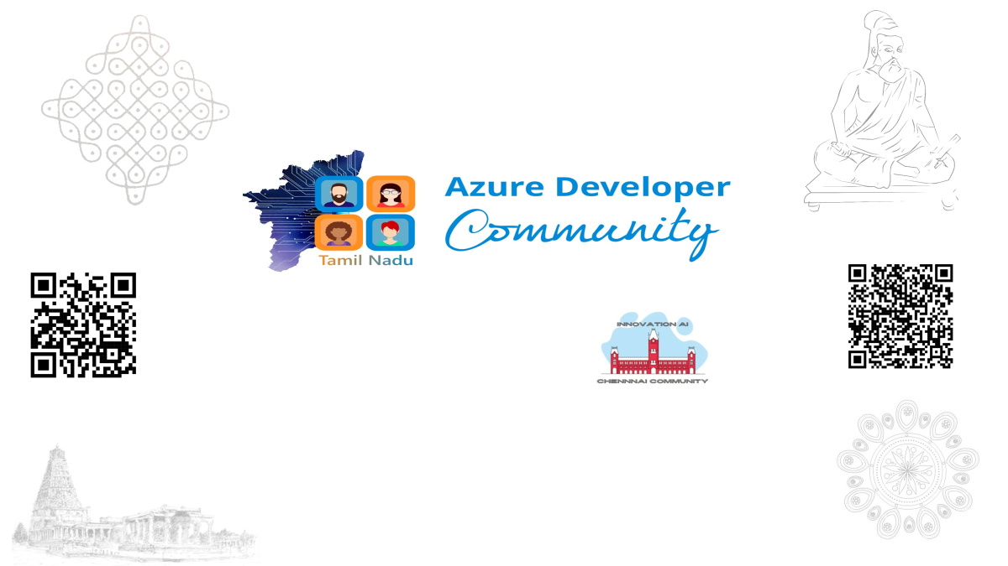

Slide 2
The Future of .NET Development
in the AI Era
Roadmap, tooling and agentic engineering practices reshaping how we build with .NET
- Naveen Prabhu Chinnadurai

Slide 3
Agenda
1. .NET 10 Roadmap & Build 2026 - what's shipping and what just shipped
2. AI-First Development & GitHub Copilot's Evolution
3. AI-Assisted Architecture & MCP (Model Context Protocol)
4. Agent-Based Development & Microsoft Agent Framework
5. Live Demo - building an agent with Microsoft Agent Framework in C#
6. Takeaway
#Azure Developer Community Tamil Nadu #Innovation AI Chennai
3

Slide 4
.NET 10 ROADMAP
.NET 10: Performance & Runtime
Long-Term Support (LTS) release - three years of servicing, the safe choice for production workloads
Deeper vectorization support, benefiting numeric and AI/ML-adjacent workloads written in C#
Continued investment in trimming and Native AOT to keep containers small for AI-infused microservices
Cold Start, Trending to Zero
Native AOT keeps shrinking spin-up time on Azure Container Apps and AWS Lambda, release after release.
3-Year LTS
Long-Term Support release - the safe, low-risk upgrade path to bring to a budget conversation.
#Azure Developer Community Tamil Nadu #Innovation AI Chennai
4

Slide 5
.NET 10 ROADMAP
.NET 10: Cloud-Native & Developer Tooling
.NET Aspire
C# Language & SDK
AI-Ready Libraries
Opinionated stack for cloud-native distributed apps
Built-in service discovery & telemetry
Growing AI & vector DB integrations
Incremental language ergonomics updates
Improved container & Docker publishing
Better diagnostics & hot-reload
Unified AI abstraction via Microsoft.Extensions.AI
Native embeddings, vector stores & chat clients
Tighter ASP.NET Core + AI middleware integration
#Azure Developer Community Tamil Nadu #Innovation AI Chennai
5

Slide 6
MICROSOFT BUILD 2026
Beyond the Roadmap: More Wow Moments From Build 2026
Four more announcements that show how far .NET's AI story reaches - from the next runtime preview to AI running on-device
.NET 11 Preview
Agentic Web
AI at the Edge
Your Agent, Anywhere
Public Preview since February 2026 - well ahead of Build
Several previews already shipped
Runtime, library & SDK gains for agent-driven apps
Native agents, tools & skills in ASP.NET Core / Blazor
Tightly integrated with Aspire
Foundation for the next gen of web apps
On-device AI models via .NET MAUI (Multi-platform App UI)
Faster, more private inference
Fully offline-capable experiences
GitHub Copilot SDK: build once
Carry across phone, cloud, any client
One portable agent, not per-surface logic
Microsoft's own framing captures the shift well: Copilot is moving from pair programmer to peer programmer - capable of taking on bugs, features, and maintenance on its own.
#Azure Developer Community Tamil Nadu #Innovation AI Chennai
6

Slide 7
MICROSOFT BUILD 2026
Straight From Build 2026: What Just Shipped
Microsoft Agent Framework reached 1.0 (GA) - the unified successor to Semantic Kernel and AutoGen
C# is getting union types - one of the most requested language features, aimed squarely at modeling and agent message shapes
Visual Studio and GitHub Copilot go deeper: agent-assisted debugging, profiling and test authoring; AI-assisted merge conflict resolution
dotnetup - a new cross-platform tool for managing .NET SDK and runtime installs, aimed at smoother onboarding
GA: April 3, 2026
Agent Framework is fully supported and production-ready - not a preview.
.NET + Python, One Model
Provider-agnostic across Azure OpenAI, OpenAI, Anthropic and local models via Ollama.
#Azure Developer Community Tamil Nadu #Innovation AI Chennai
7

Slide 8
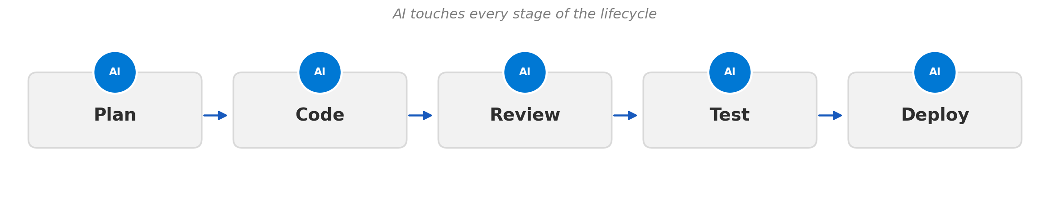
AI-FIRST DEVELOPMENT TRENDS
What 'AI-First' Actually Means
Code generation has moved from autocomplete to task-level delegation
AI is embedded across the lifecycle, not just the editor
Prompt and context engineering is becoming a core developer skill
Trust is earned incrementally - teams still gate AI output behind tests, review and CI
#Azure Developer Community Tamil Nadu #Innovation AI Chennai
8

Slide 9
GITHUB COPILOT EVOLUTION
Copilot's Evolution
1
→
2
→
3
→
4
Inline Completions
Copilot Chat
Workspace & Multi-File Edits
Copilot Agent Mode
Ghost-text suggestions as you type, trained to predict the next tokens in context.
Conversational assistant inside the IDE for Q&A, explanations and targeted edits.
Understands a whole repo well enough to plan and apply changes across many files.
Given a task, it plans, edits, runs tools, iterates on failures and reports back autonomously.
#Azure Developer Community Tamil Nadu #Innovation AI Chennai
9

Slide 10
GITHUB COPILOT EVOLUTION
Copilot Agent Mode in a .NET Workflow
Task-driven
Tool use inside the loop
Custom instructions and extensions
Human stays the reviewer and approver
Example in Practice
“Add rate limiting - 100 req/min” becomes middleware, DI wiring and a test - drafted automatically.
Self-Verifying
Runs dotnet build and dotnet test itself, fixing failures, before it ever shows you a diff.
#Azure Developer Community Tamil Nadu #Innovation AI Chennai
10

Slide 11
AI-ASSISTED ARCHITECTURE
Where AI Fits in Architecture Work
Design Exploration
Code-to-Diagram & Back
Guardrails That Still Matter
Draft alternative designs (e.g. monolith vs. microservices)
Summarize trade-offs against real constraints
Generate ADRs as a starting draft
Generate dependency & sequence diagrams
Flag layering violations & architecture drift
Keep docs synchronized with the codebase
AI proposals are drafts - human judgment stays final
Non-functional requirements need human validation
Version-control ADRs for traceability
#Azure Developer Community Tamil Nadu #Innovation AI Chennai
11

Slide 12
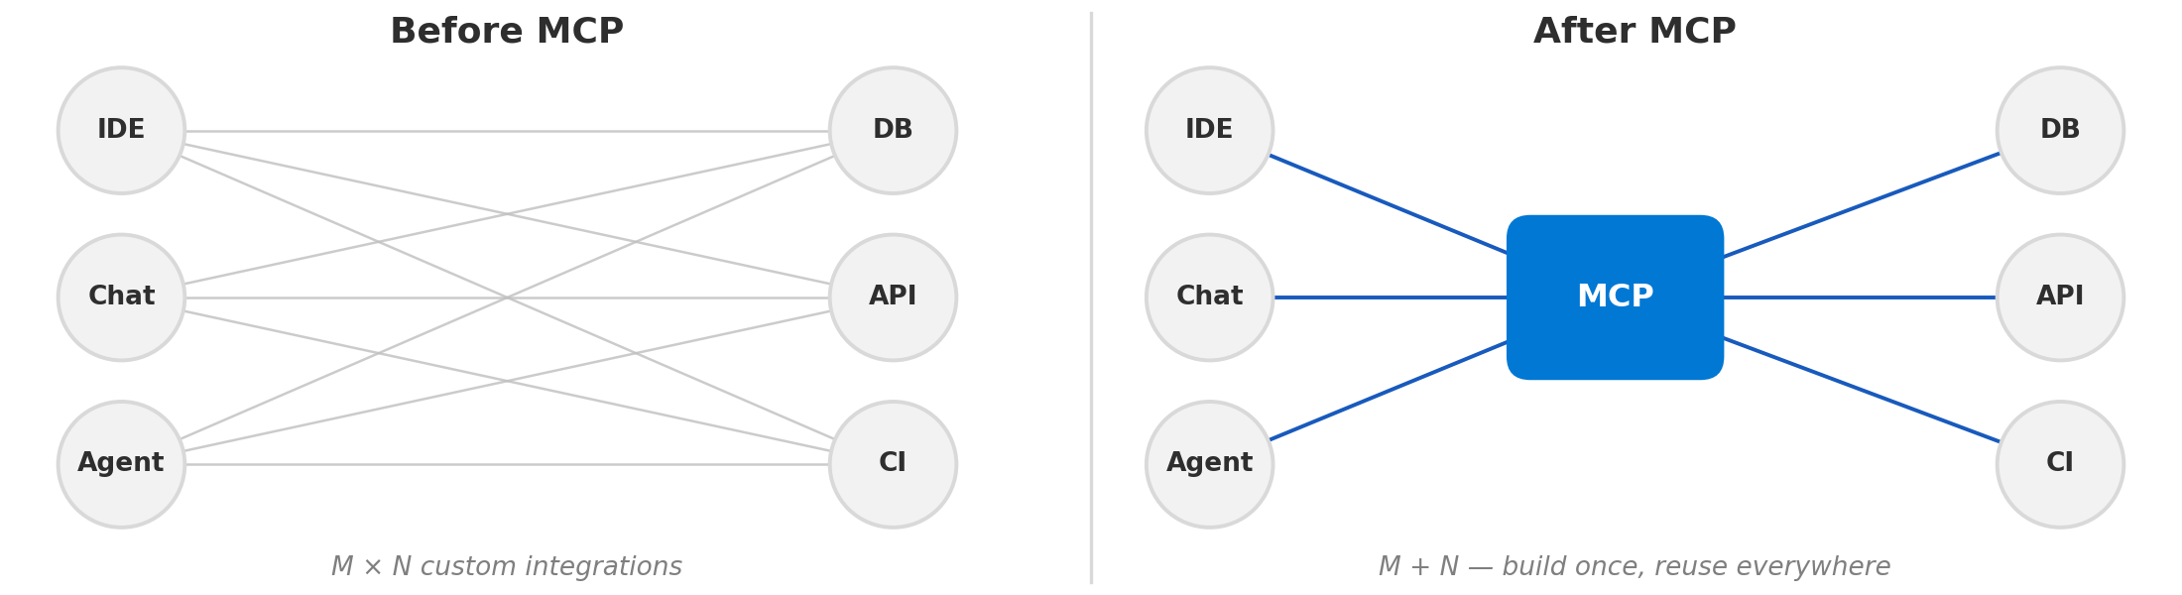
MCP (MODEL CONTEXT PROTOCOL)
What Problem MCP Solves
Before MCP: every AI tool needed a bespoke, one-off integration with every data source or service
MCP defines a common client-server protocol for exposing tools, data and prompts to AI models
Turns the M×N problem into an M+N problem - build the integration once, reuse it everywhere
#Azure Developer Community Tamil Nadu #Innovation AI Chennai
12

Slide 13
MCP (MODEL CONTEXT PROTOCOL)
MCP Architecture & .NET Use Cases
AI Client
(IDE / Copilot / Agent)
MCP Server
Database
MCP
Internal API
File System
A .NET service or CLI can implement an MCP server, exposing internal tools/data through a standard interface any compatible AI client can call.
Build / CI
Practical .NET use cases
  Expose an internal ticketing or CRM API as an MCP server so Copilot or other agents can query it during dev work
  Give an AI coding agent controlled access to run dotnet build/test through an MCP tool rather than raw shell access
  Let a support or ops agent query production telemetry through a governed MCP interface, not direct database credentials
#Azure Developer Community Tamil Nadu #Innovation AI Chennai
13

Slide 14





AGENT-BASED SOFTWARE DEVELOPMENT
Evolving into Agentic AI
From a single expert consultant to an entire factory - zooming out from the micro to the macro
1 · Generative AI
2 · AI Agents
3 · Agentic AI
The Expert Consultant
The Active Worker
The Entire Factory
Passive, one-shot: prompt in, answer out
Stateless - no memory
e.g. ChatGPT, Claude, Gemini
Can generate, but can’t act
Active perceive-reason-act loop
Stateful - remembers plan & history
Tools + memory = LLM as a component
User hands off a goal
Specialized agents collaborate
Router + specialist agents
Challenge: system-wide orchestration
User hands off a complex goal
→
→
→
→
→
→
More Human Intervention
Less Human Intervention
#Azure Developer Community Tamil Nadu #Innovation AI Chennai
14

Slide 15
AGENT-BASED SOFTWARE DEVELOPMENT
What Changes with Agent-Based Development
From 'suggest a line' to 'own a task'
  Agents take a goal (a bug report, a small feature, a dependency upgrade) and work it to completion
Agents increasingly operate with real tool access via MCP: build systems, test runners, issue trackers
Frameworks like Microsoft Agent Framework give .NET teams a structured way to build these agents, not just consume them
New team practices are emerging
  Clear, well-scoped task definitions become as important as the code itself
  CI/CD, tests and code review become the primary trust boundary for agent output
  Teams are experimenting with multi-agent setups: a planner, an implementer and a reviewer agent
Human role shifts toward directing, reviewing and setting guardrails rather than typing every line
#Azure Developer Community Tamil Nadu #Innovation AI Chennai
15

Slide 16
MICROSOFT AGENT FRAMEWORK
What is Microsoft Agent Framework?
Microsoft Agent Framework is an open-source SDK for building AI agents and multi-agent workflows in .NET and Python - the direct successor that merges Semantic Kernel and AutoGen into one supported foundation.
Open Standards & Interoperability
Enterprise Ready
Research Pipeline
Radically Simple to Start
Built-in support for MCP, Agent-to-Agent (A2A) communication and OpenAPI - agents aren't locked to one runtime or vendor.
Inherited from Semantic Kernel: thread-based state management, type safety, filters and telemetry out of the box.
Inherited from AutoGen: advanced orchestration patterns - group chat, debate, reflection - available as building blocks.
A functional agent in under 20 lines of code. Microsoft's own framing: “building AI agents shouldn't be rocket science.”
Bottom line: one framework for both quick single agents and complex graph-based multi-agent workflows - not a choice between innovation and production stability.
#Azure Developer Community Tamil Nadu #Innovation AI Chennai
16

Slide 17
MICROSOFT BUILD 2026 · AGENT FRAMEWORK
Microsoft Agent Framework Reaches 1.0 (GA)
Agent Harness, Foundry Hosted Agents and CodeAct headline a wave of production-focused features
Agent Harness
Foundry Hosted Agents
CodeAct
Handoff Orchestration
Built-in production patterns: context compaction, file memory, todo tracking, shell execution and human-in-the-loop approvals - one method turns any chat client into a full agent.
Deploy a local agent to production in a few lines: scale-to-zero billing, session state that survives restarts, per-session sandboxes and built-in OpenTelemetry tracing.
Instead of one model turn per tool call, the model writes a single program that calls every tool at once, run in an isolated micro-VM - fewer round-trips, less latency.
Declare specialist agents and the routes between them; the framework wires up the hand-off tools so agents can transfer control mid-conversation.
CodeAct Benchmark - Multi-Step Tool-Calling Workload
Also Reaching 1.0
52.4%
63.9%
GitHub Copilot SDK as an agent backend (shell, files, URL fetch, MCP)
Handoff orchestration for multi-agent routing (.NET + Python)
Convergence of AutoGen and Semantic Kernel into one supported SDK
Time saved · 27.81s → 13.23s
Tokens saved · 6,890 → 2,489
Microsoft Agent Framework reached 1.0 GA on April 2, 2026 · Source: Microsoft Agent Framework devblog, Build 2026
#Azure Developer Community Tamil Nadu #Innovation AI Chennai
17

Slide 18
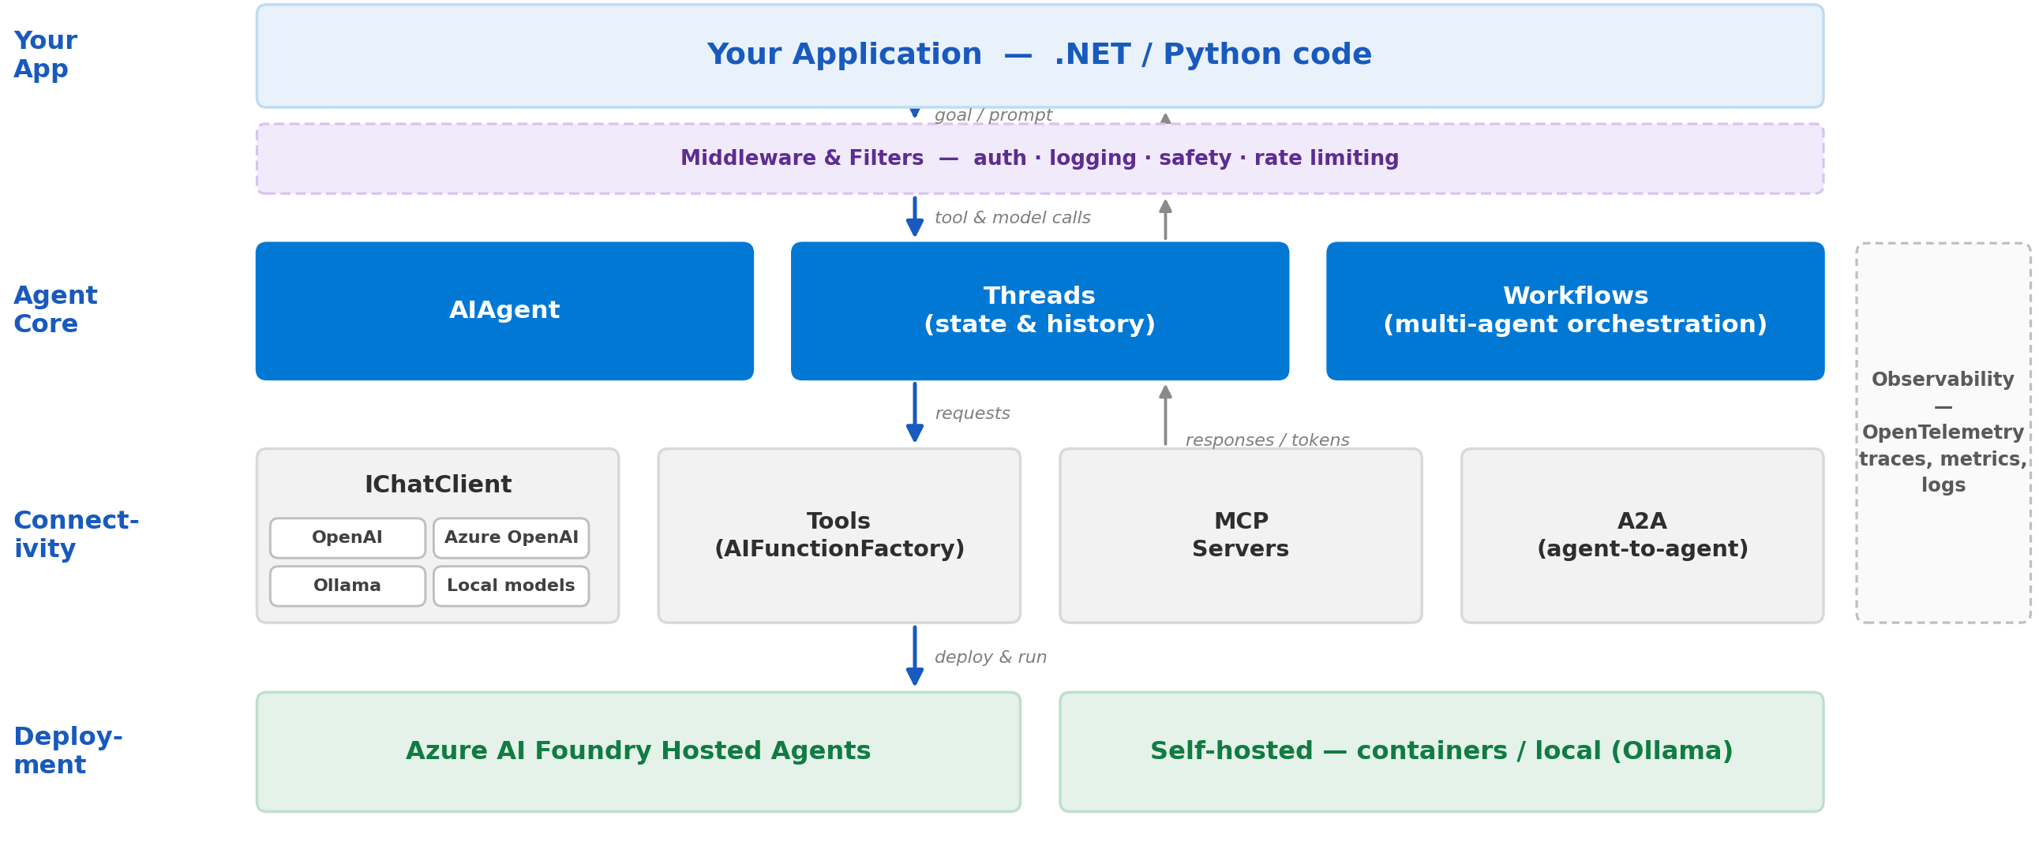
MICROSOFT AGENT FRAMEWORK
Microsoft Agent Framework: Architecture at a Glance
#Azure Developer Community Tamil Nadu #Innovation AI Chennai
18

Slide 19
Live Demo
Building and running an agent with Microsoft Agent Framework in C#

Slide 20
LIVE DEMO
From Zero to Working Agent in C#
1
→
2
→
3
→
4
Create the Agent
Register a Tool
Plug in an MCP Server
Run & Stream
One AIAgent from any IChatClient - today, a local model via Ollama, no API key or cloud spend required.
A plain C# method plus [Description] becomes a callable tool via AIFunctionFactory.Create() - no hand-written JSON schema.
McpClient.CreateAsync() discovers a server’s tools and hands them to the agent as ordinary AITool instances.
agent.RunStreamingAsync() drives the loop - it reasons, calls tools and streams the answer back token by token.
#Azure Developer Community Tamil Nadu #Innovation AI Chennai
20

Slide 21
TAKEAWAY
What to Learn Next?
Prompt & Context Engineering
Agentic Coding Fluency
MCP & Tool Integration
Agent Orchestration
AI-Aware System Design
Observability for AI Systems
FOR FURTHER READING
.NET 10 - What's New
GitHub Copilot - Agent Mode & MCP
Model Context Protocol - Spec & Docs
Microsoft Agent Framework Docs
Azure AI Foundry Agent Service
#Azure Developer Community Tamil Nadu #Innovation AI Chennai
21

Slide 22
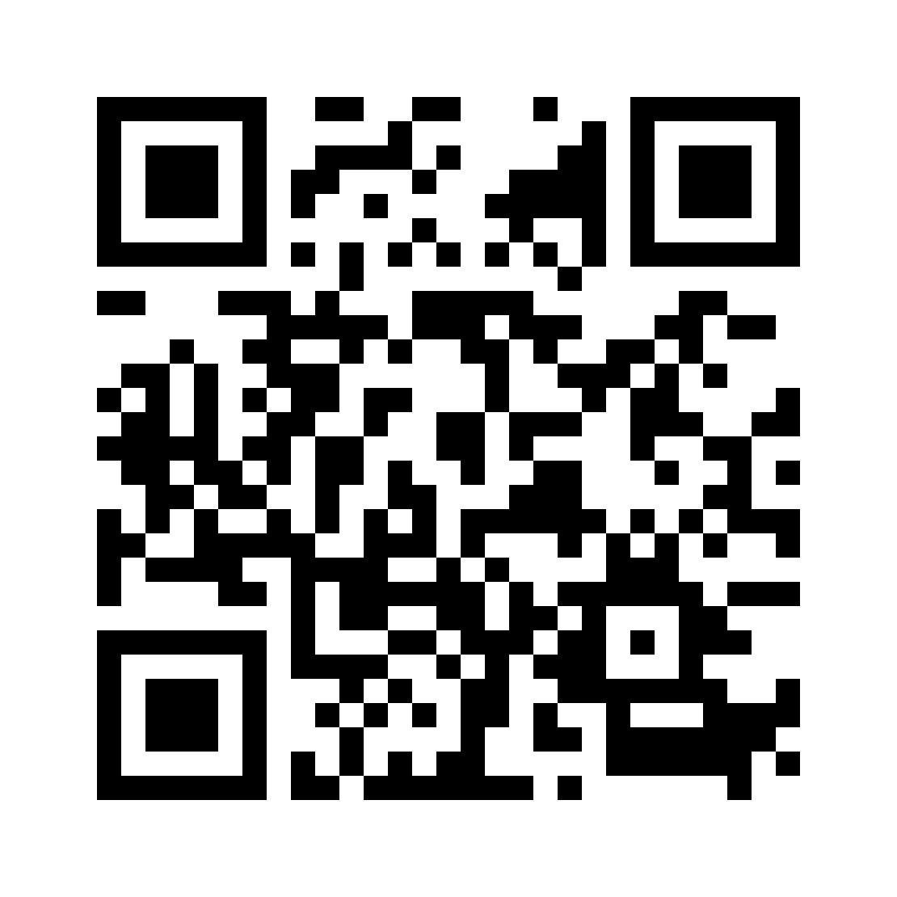

Questions & Answers
Connect on LinkedIn
Naveen Prabhu Chinnadurai
Thank You!
நன்றி!

